Slide 1

Predicting Cannabis Strain Rating
Taylor Van Valkenburg, Kristen Celotto, Victor Hugo Mazariegos, and Mark Pipher

Slide 2
Overview
Business Objective
01
Data Exploration
02
Data Preprocessing
03
Modeling
04
Conclusions
05

Slide 3
Business Objective

Slide 4


Business Objective
Predict a product rating in order to allow business owners to intelligently stock only the most popular inventory. In addition, this information would be useful for investors to know which strains would be worthwhile investments.
The product rating is to be predicted using user description, flavor, effects and type.

Slide 5
Data Exploration

Slide 6

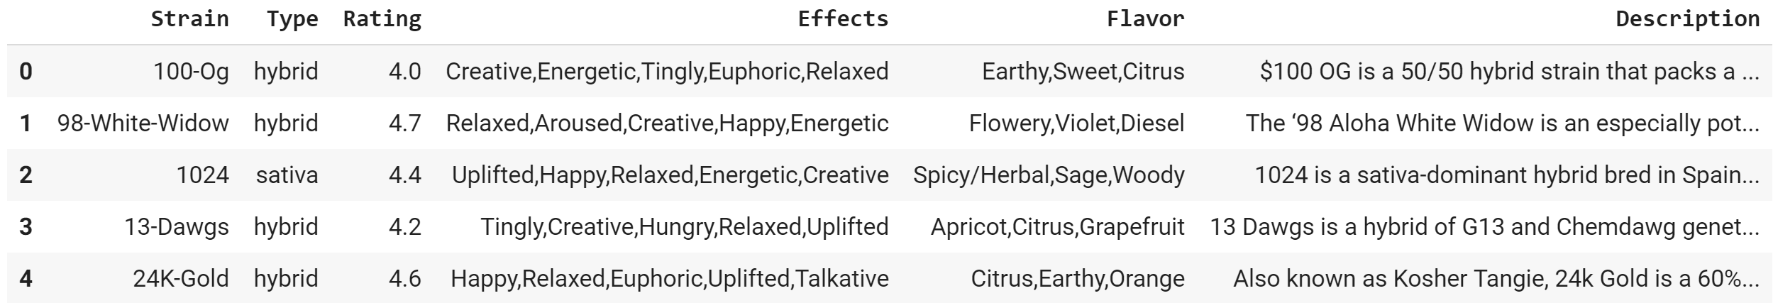
Exploration - Overall
Shape of dataset (2351 rows, 6 columns)
Flavor and Description <2351 rows
Data issue 1 – Null values in Description
Rows were deleted
Data issue 2 – Null values in Flavor
If flavor was mentioned in description/strain fill with that value, if not the rows were kept
Data issue 3 – Duplicated Strains
Search and delete duplicated strains (B-Witched was identified and removed)
Notes:
There were 8 strains which included mention of flavors

Slide 7


Dataset Variables
Rating – Continuous (Range = 0 to 5)*
Strong left skew, median value = 4.4
Mean Rating = 4.3
Rating std. Dev = 0.83
Description – String
Flavor – String
Effects – String
Type – String
*Response Variable
Notes:
In the first section of our analysis we explored the data. Since the features that we had to work with were all text, this involved extensive use of the NLTK library, as well as a number of visualizations, to understand the data set.

Slide 8
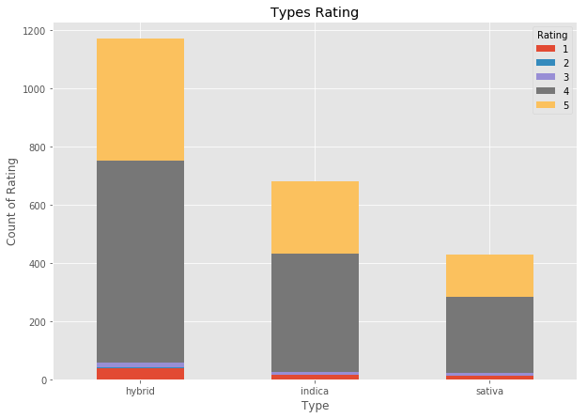
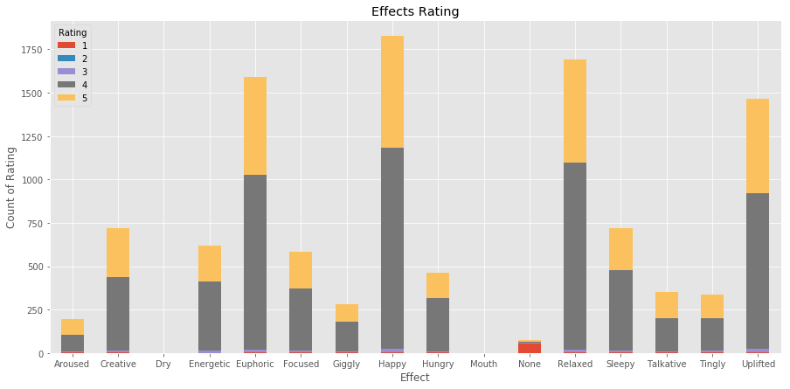
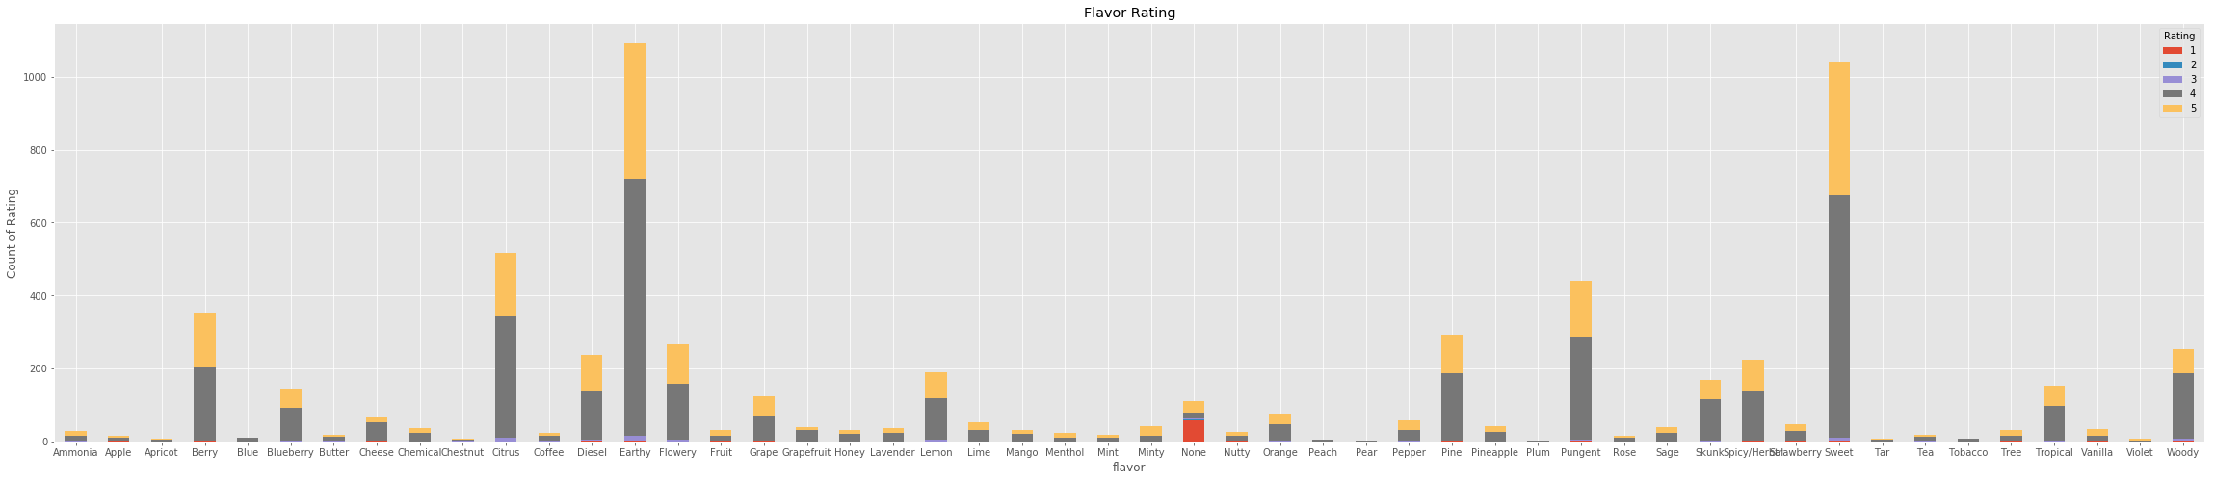
Rating by Type, Effect, Flavor
Notes:
Hybrid received more 5 and 4 ratings
The most common effects were Happy, Euphoric, relaxed and uplifted
Earth and sweet seem to be the predominant flavours of the products rated 4-5 which is our target grouping

Slide 9
Data Pre-Processing

Slide 10
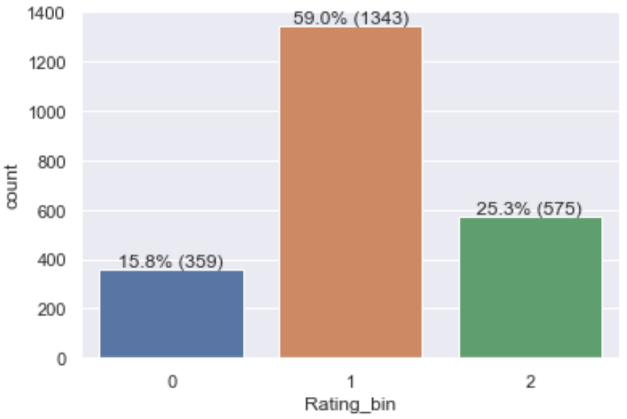
Data Binning
The data was binned according to the data skew into three categories
Bins
1: rating < 4.2
2: 4.2 < rating < 4.7
3: rating ≥ 4.7
Notes:
Transform our target variable – the rating – by separating the samples into bins based on their scores.
The bins represent strains that should not be stocked, that should be considered, and that should definitely be stocked.
This allowed us to approach the problem as a classification problem rather than a regression problem, and had the added advantage of making our models’ outputs more intelligible to end users.
Stock it or don’t stock it

Slide 11
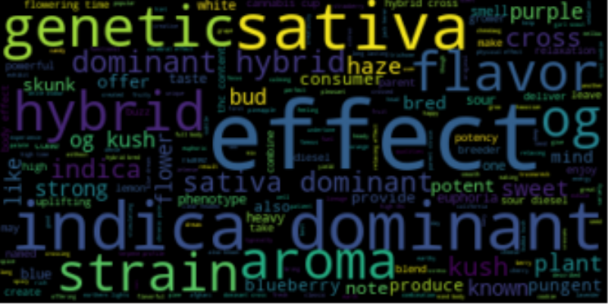
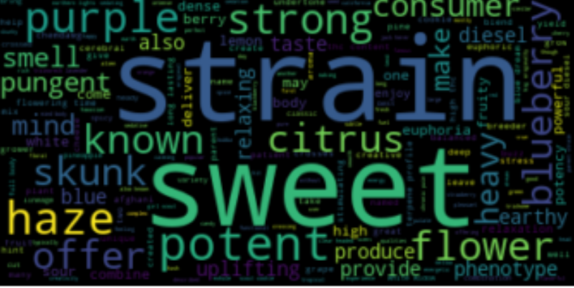
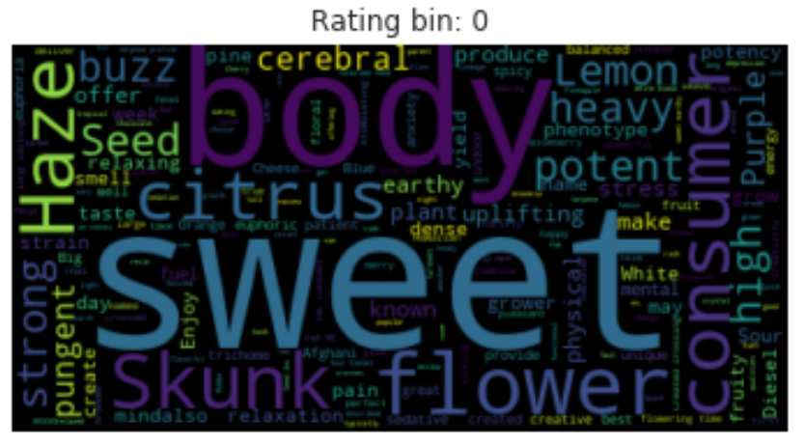
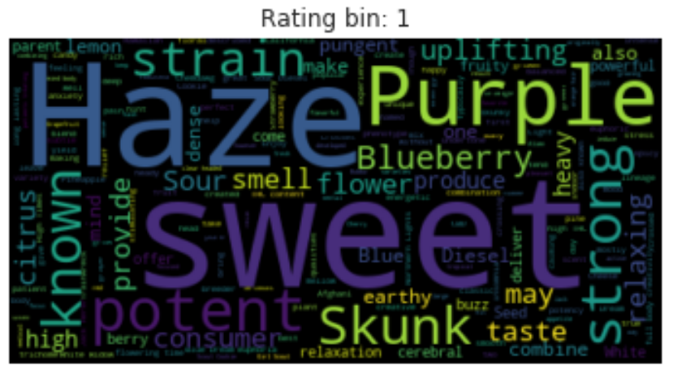
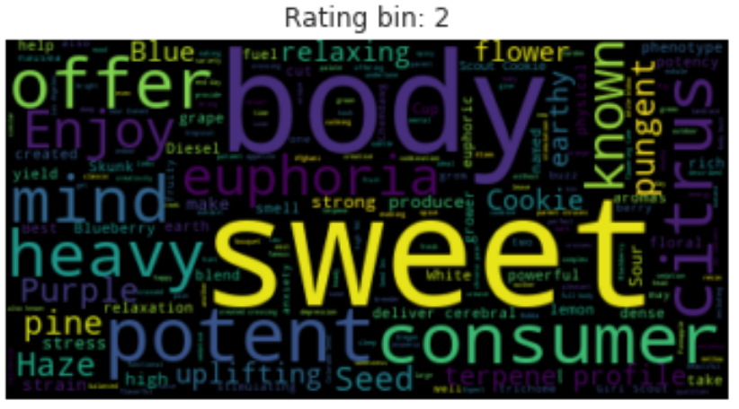
Visualizing the Most Frequent Descriptors
Most common words in descriptions
All strains new stop words
1
2
3
Notes:
Since there are some words that are seen frequently through all descriptions we will add those to the stop words to observe more unqiues words that have strong effect on the different ratings
new_stop_words = stop_words + ['strain','genetic','sativa','hybrid','indica','effect','plant','aroma','dominant','genetics','effects','flavor','bred','like','cannabis','cross','kush','og','bud','buds','note','flavors','notes']
Through these word clouds we can see that flower frequently observed in bin 0 and is less common in bin 1 or bin 2, Another word that stands out is potent which is seen much more frequently in bin 1 and bin 2 than seen in bin 0. Haze is less frequently observed in the highest customer rating compared to rating less than 4.7.
Description has the most influence on the models since we have to convert the words to vectors. This will drastically increase the amount of attributes in the models which if not careful can minimize the influence of the other attributes. To combat this we have duplicated the type attribute multiple times, this will allow the Type attribute to have an equal weight compared to Description. Effect and Flavor can often be seen already in the description making those two attributes less important in the models and could poteinally be added into the descriptions.

Slide 12
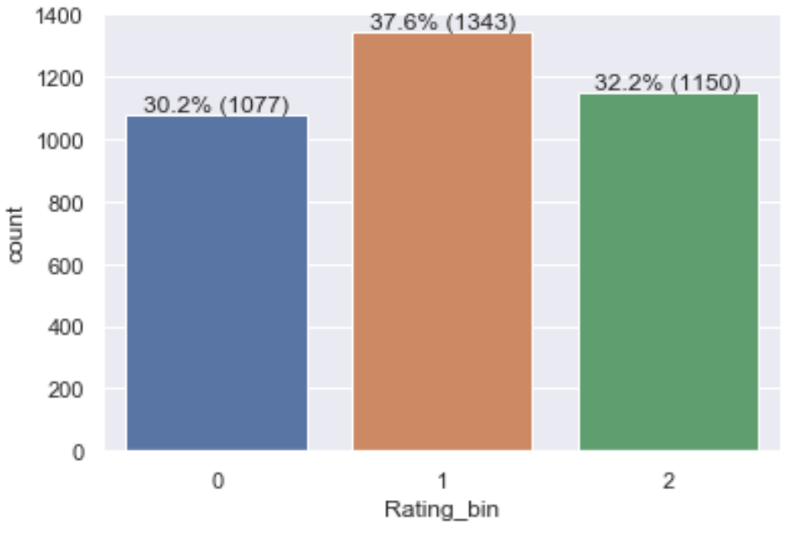
Correcting for Data Imbalance
To correct for a large data imbalance between the 3 bins, oversampling was used
Class 0 required oversampling 3 times
Class 2 required oversampling 2 times
#create dataframes for 0 & 2 classes
class_0 = df1.loc[df1['Rating_bin'] == 0]
class_2 = df1.loc[df1['Rating_bin'] == 2]
df1 = df1.loc[df1['Rating_bin'] != 0]
df1 = df1.loc[df1['Rating_bin'] != 2]
#oversample class 2
df1 = pd.concat([df1, class_2])
df1 = pd.concat([df1, class_2])
Notes:
It is clear from the chart and table above that the data is imbalanced.
60% of examples were in one class. When the models were run using this unbalanced data, they all eventually determined that the best model was one that always picked the overrepresented class, and by doing so achieve 60% accuracy
The balance the data, the data labelled as either class 0 or class 2 will be oversampled. Class 0 will be oversample 3 times, and class 2 twice.

Slide 13
NLTK
Data required cleaning -> FXN removed lowercase, stop words, punctuation, special characters, stemmed the word and tokenized where applicable
#define the cleaning function for scikit learn
def clean_text_skl(text):
#make all words lowercase
clean_skl = text.lower()
#tokenize and remove special characters
tokenizer = RegexpTokenizer(r'\w+')
clean_skl = tokenizer.tokenize(clean_skl)
#lemmatize the text
#clean_skl = [WordNetLemmatizer().lemmatize(w) for w in clean_skl]
clean_skl = [SnowballStemmer(language='english').stem(w) for w in clean_skl]
#remove stopwords
clean_skl = [token for token in clean_skl if not token in stopwords.words('english')]
clean_skl = ' '.join(clean_skl)
return clean_skl

Slide 14


Preprocessing Models x2
Scikit-learn’s count vectorizer
1. Sentences into numerical features
2. TD-IDF to determine importance of each word
Word2Vec
1. 1-layer neural network predicting probability words appear near each other
2. Extract word embeddings (weights in hidden layer)
3. Constructed the feature matrix using the mean of each word’s vector
Notes:
We took two different approaches to preprocessing in order to clean the data

Slide 15
Modeling

Slide 16
Model Overview
KNN, SGDClassifier, RandomForestClassifier, and neural network with Keras
Each had Count Vectorizer and Word2Vec feature vectors applied (Total of 8 models)
Scikit Learn models were tuned with a 3 fold gird search
Keras model was built using 4 hidden layers, with 5 nodes, using relu activation fxn
All models were evaluated on their training data using 3 fold & 10 fold cross validation
Notes:
All models were evaluated on their training data using 3 fold and 10 fold cross validation. Using this we were able to ensure that the models were not overfitting.

Slide 17
Models Performance
Models performed similarly on both preprocessed datasets
scikit learn had over 10,000 columns in the feature matrix, genism had only 100
Gensim superior due to less training time
Scikit-learn Test Set Accuracies
SGD model is: 0.4921
Random Forest model is: 0.8123
KNN model is: 0.5191
Keras model is: 0.4687
Gensim Test Set Accuracies
SGD model is: 0.4566
Random Forest model is: 0.8357
KNN model is: 0.5285
Keras model is: 0.4388
Notes:
As can be seen above, the SGD, KNN, and Keras models all performed relatively poorly, and were underfitting the data. Furthermore, they all performed more or less comparably. Train set and test set accuracy were similar in all cases, using both 3 fold and 10 fold cross validation on the training sets. The Keras model was improved to show as high as 70% accuracy on the test set, but this came with a training set accuracy of 99%, and so was clearly an example of overfitting.
However, in both cases the Random Forest model performed well. The accuracy on the training set and test set was comparable, and in fact was higher on the test set.
Only random forest was able to successfully capture complexity without overfitting

Slide 18

Random Forest
Performed worst with 3 fold cross validation (around 72%)
Performed second worst with the 10 fold cross validation (around 78%)
Performed best on the test set (around 82%)
Gensim
precision recall f1-score support
0 0.87 0.93 0.90 323
1 0.83 0.80 0.81 403
2 0.81 0.80 0.80 345
accuracy 0.84 1071
macro avg 0.84 0.84 0.84 1071
weighted avg 0.83 0.84 0.83 1071
Scikit-learn
precision recall f1-score support
0 0.84 0.93 0.88 323
1 0.82 0.75 0.78 403
2 0.78 0.78 0.78 345
accuracy 0.81 1071
macro avg 0.81 0.82 0.81 1071
weighted avg 0.81 0.81 0.81 1071
Notes:
This is odd behaviour and may be related to the fact mentioned above – that some data in the test set is a copy of data in the training set. However, in any case the algorithm attained an accuracy of between 72% and 82%, and so was a successful model.
Precision and recall were also analyzed for all models. The Random Forest model displayed balanced precision and recall – they were similar to each other, and each class had precision and recall similar to the overall accuracy of the model. The tables below show the two metrics for the two methods of preprocessing the data:

Slide 19
Conclusions

Slide 20



Results
Random forest is a good working model and is expected to perform well in production
Our recommendation is for dispensary owners to use this algorithm to test proposed strains based on user input so that they can determine which to stock
In order to improve the model, there are several steps that could be taken.
1. Acquire more training data, particularly in the under represented classes.
2. The model would benefit from further hyper-parameter tuning.
Notes:
More data would improve the model’s performance, and would also limit the need to over sample.
Given the complexity of the model (high n_estimators and high max_depth), the random forest classifier took a very long time to perform grid search. A possible improvement would be to do a randomized search on a greater number of hyper parameters in order to determine where to focus the full grid search.

